Slide 1
Democracy, propaganda, Capitalism
Justin Murphy, PhD
University of Southampton
jmrphy.net
@jmrphy

Slide 2
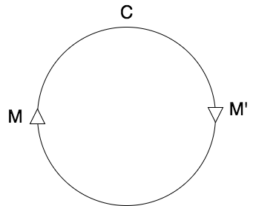
What is capitalism?
Diagram of Marx
Notes:
Capitalism is based on a fundamental form of positive feedback.
Intelligence of capitalism colonizes the intelligence of humans. And it’s takeoff.
But there’s no intelligent adjudication of final goals. What matters to us? Intelligence can’t say.

Slide 3
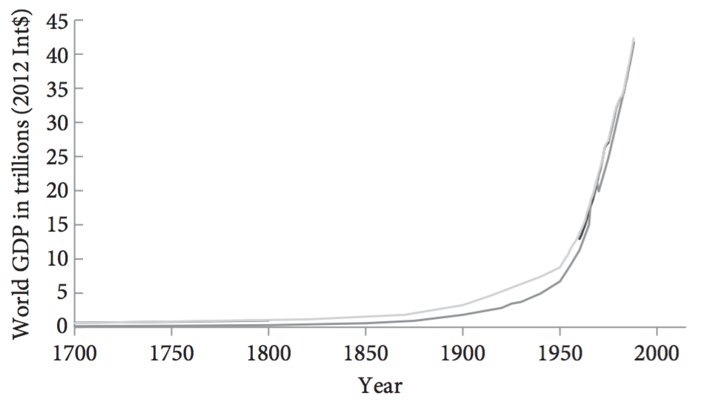
Bostrom, Nick. 2014. Superintelligence: Paths, Dangers, Strategies. Oxford: Oxford University Press.
Notes:
So we might ask, how do we get embroiled in these interminable collective confusions?
Capitalism is intelligence become autonomous. No goal but the increasing of intelligence.

Slide 4
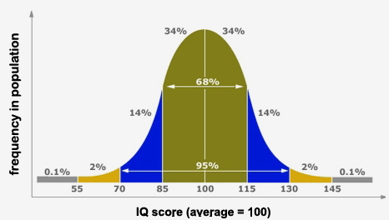
Notes:
Many political problems are knots of conflicting instrumental communication. Left tells a lie, right tells a lie: doom over time.
Consider IQ differences. They exist. Left denies their importance (all social conditioning), the Right overstates their importance (denies equal human dignity & obligation).
IQ as a case study of unbearable acceleration leading to universal confusion.
Capitalism selects for intelligence, but intelligence is unequally distributed.
So, inequality.
The greater the information processing power, the more efficient is sorting.
So the most capable have the incentives and capacities to escape obligations to the less powerful.
- geographical sorting, gated communities, tax reform, media influence
The least capable have real incentives to inflate their intelligence, deny reality, & manipulate etc.
- They will convince most people beneath them.

Slide 5
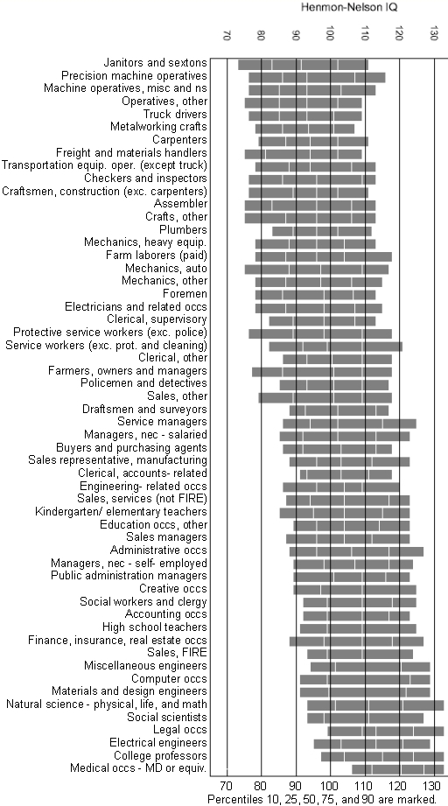

Slide 6
Accelerationism identifies the basic diagram of modernity as explosive…. It is the firm prediction of accelerationism, therefore, that the typical practical topic of modern civilization will be the controlled explosion, commonly translated as governance, or regulation.
- Nick Land, Teleoplexy

Slide 7
Most People think Propaganda is a tendency of authoritarian governments.

Slide 8
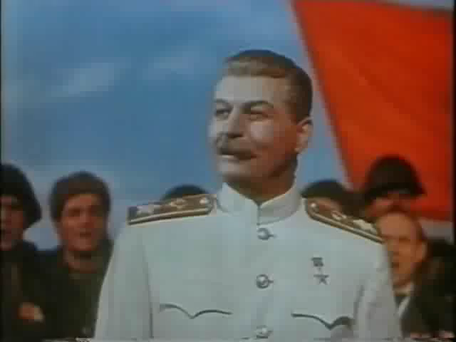

Slide 9
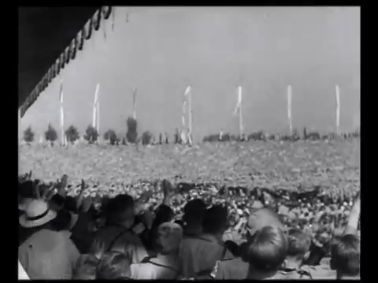

Slide 10


Slide 11
On the other hand, Most People Think
Free and open exchange of ideas is the tendency
Of Liberal / Capitalist/ Democratic governments.

Slide 12
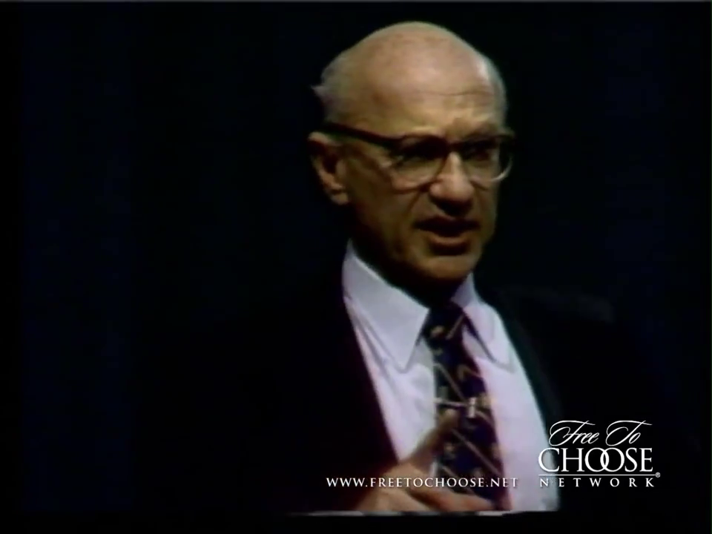

Slide 13
This is wrong.
I will make the following arguments:
Modern mass propaganda was invented under liberal capitalism.
Indeed, the notion of “Democracy” is perhaps the most successful piece of propaganda ever deployed; to the benefit of corporate and state elites seeking to silence the actual movement of real democracy.
2. Exciting new research using new data and new methods generates some unexpected evidence for this perspective.

Slide 14
1. Modern MASS Propaganda was invented under Liberal Capitalism
The first nation-wide, systematic manipulation of public opinion was by the United States government in WW1.
The U.S. public was strongly opposed to entering WWI.
After election (1916), the Wilson administration decides to enter.
Wilson administration conducts a systematic propaganda campaign.
Committee on Public Information, aka the Creel Commission.

Slide 15
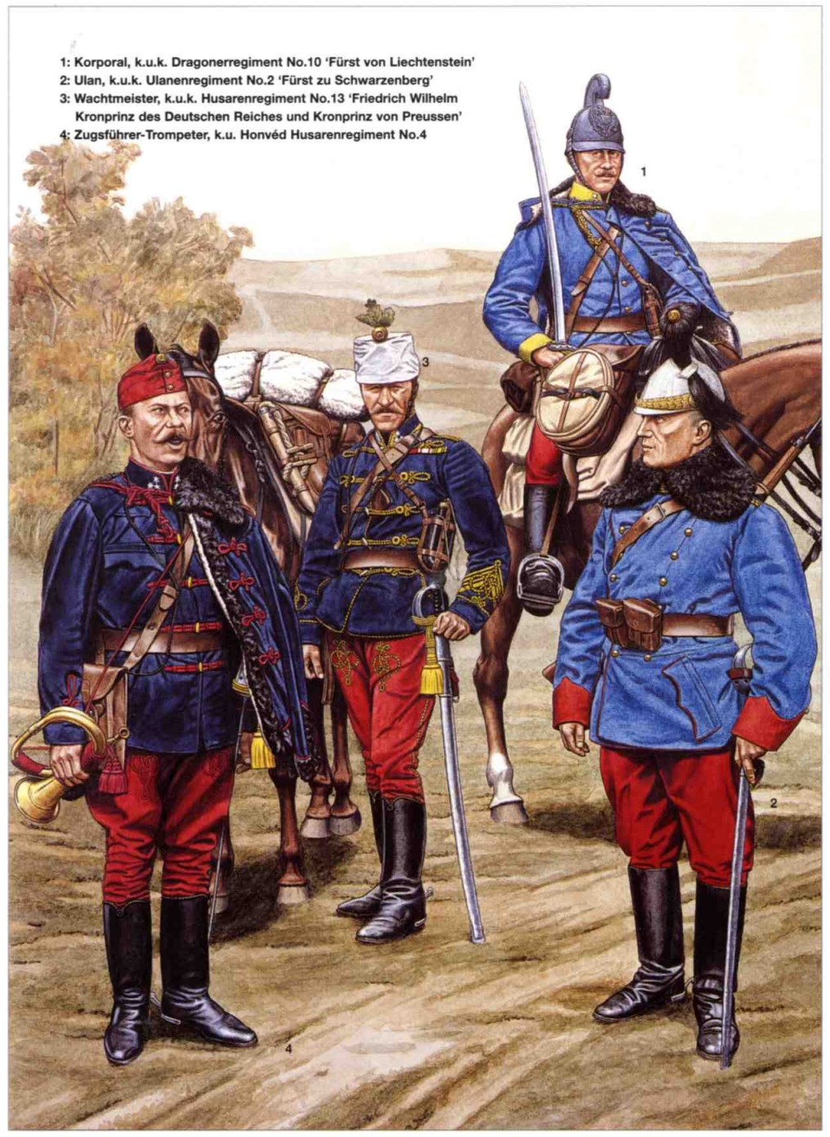
Austro-Hungarian Calvary in WWI

Slide 16
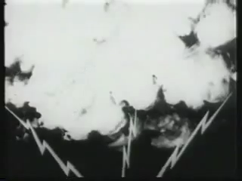

Slide 17
1. Modern MASS Propaganda was invented under Liberal Capitalism
The first nation-wide, systematic manipulation of public opinion was by the United States government in WW1.
The U.S. public was strongly opposed to entering WWI.
After election (1916), the Wilson administration decides to enter.
Wilson administration conducts a systematic propaganda campaign.
Committee on Public Information, aka the Creel Commission.
This launches the propaganda of “Democracy” as a good thing states would now claim to be.
Hitherto, “democracy” had always meant “chaos” & states were there to prevent it. It had always been a pejorative, much like how many people say “anarchy” today.

Slide 18
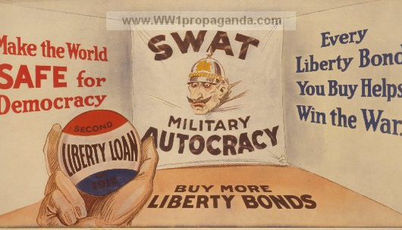

Slide 19
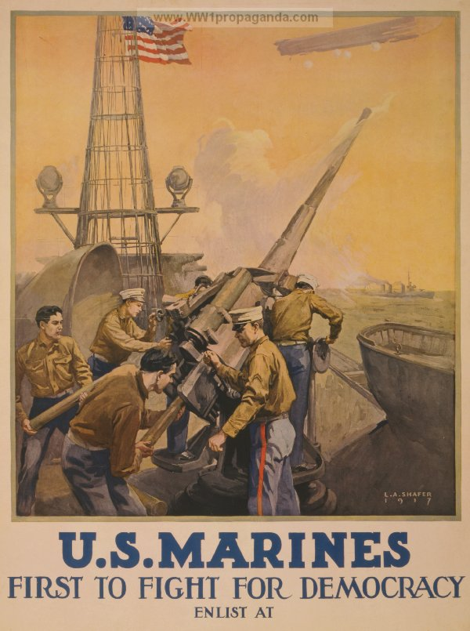

Slide 20
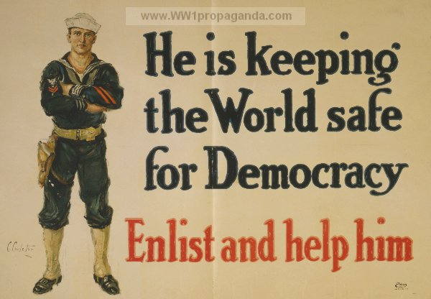

Slide 21
Let’s look Deeper Into the Fossil Record.

Slide 22
Percentage of books containing each word per year, based on a sample of about 4% of all books, via Google’s “Ngram” database.

Slide 23
1. Modern MASS Propaganda was invented under Liberal Capitalism
The first nation-wide, systematic manipulation of public opinion was by the United States government in WW1.
The U.S. public was strongly opposed to entering WWI.
After election (1916), the Wilson administration decides to enter.
Wilson administration conducts a systematic propaganda campaign.
Committee on Public Information, aka the Creel Commission.
This launches the propaganda of “Democracy” as a good thing states would now claim to be.
Hitherto, “democracy” had always meant “chaos” & states were there to prevent it. It had always been a pejorative, much like how many people say “anarchy” today.
Also launches the propaganda equation “nation = business”
Therefore “unions = bad for the nation.”
Workers were largely opposed to the “rich man’s war.”

Slide 24
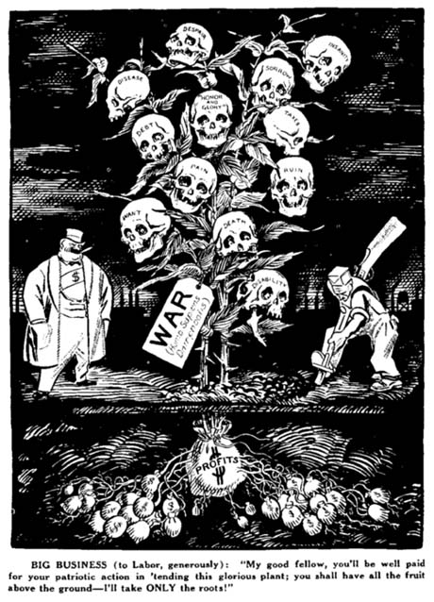

Slide 25


Slide 26
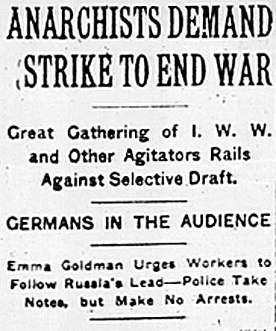

Slide 27
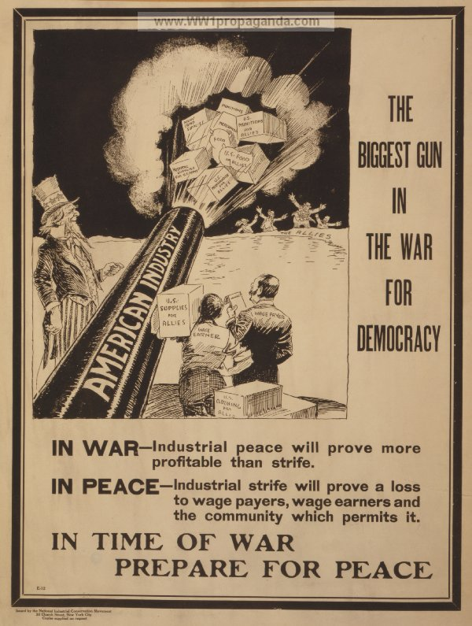

Slide 28
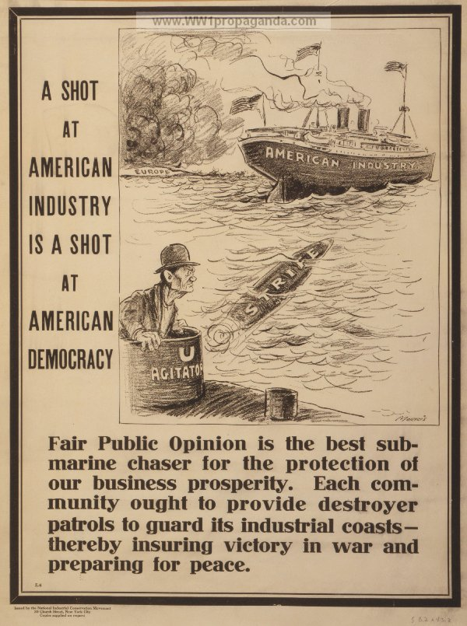

Slide 29
2. Current Research
Two interesting, recent pieces which are curiously supportive of my argument (although they don’t quite frame their findings this way!)
Western television entering into East Germany made East Germans more satisfied with their authoritarian government (Kern and Hainmueller 2009).
- Natural experiment exploiting topography
- Survey data, exit visas, and government documents
B. The more mass media in a country, the less likely is a civil war to occur (Warren 2014).
- This is true controlling for level of democracy
- This is true controlling for media freedom

Slide 30
Conclusion
1. Historically, modern mass propaganda is first and foremost a product of liberal, capitalist government rather than authoritarian government.
2. “Democracy” as we know it today, as an international ideal of what states claim to be, was only born as propaganda for capitalism.
“Democracy” was launched quite explicitly to silence the organic, militant “democracy” of workers and radicals trying to overthrow capitalism and resist the “rich man’s war.”
3. New data and advanced research methods are possibly suggesting interesting new evidence for this perspective.
Thanks!

